Slide 1
JavaScript: Client-Side Scripting
CS 135

Slide 2
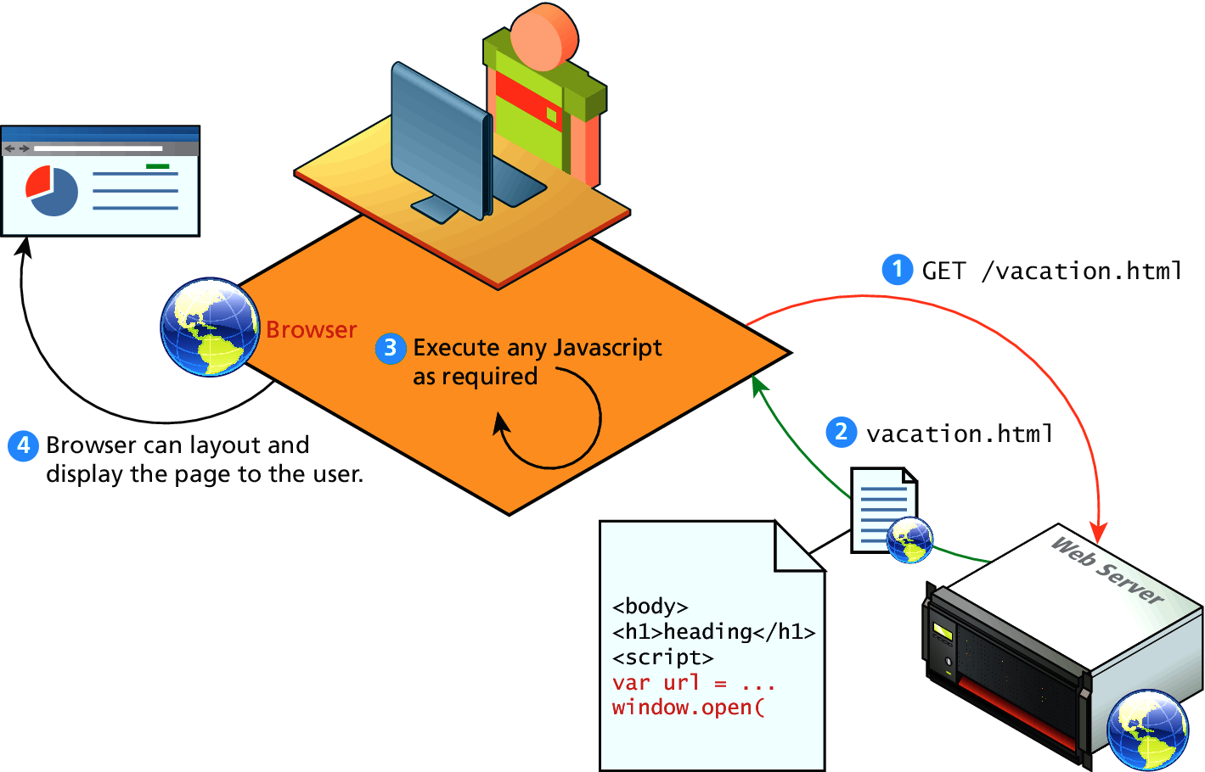
What is JavaScript
One of 3 languages for all web developers must learn:
HTML to define the content of web pages
CSS to specify the layout of web pages
JavaScript to program the behavior of web pages
JavaScript runs right inside the browser
JavaScript is dynamically typed
JavaScript is object oriented in that almost everything in the language is an object
Hmm…except it doesn’t support OO concepts like inheritance or polymorphism
And it has nothing to do with Java (it does not run on JVM and its not fully OO)

Slide 3
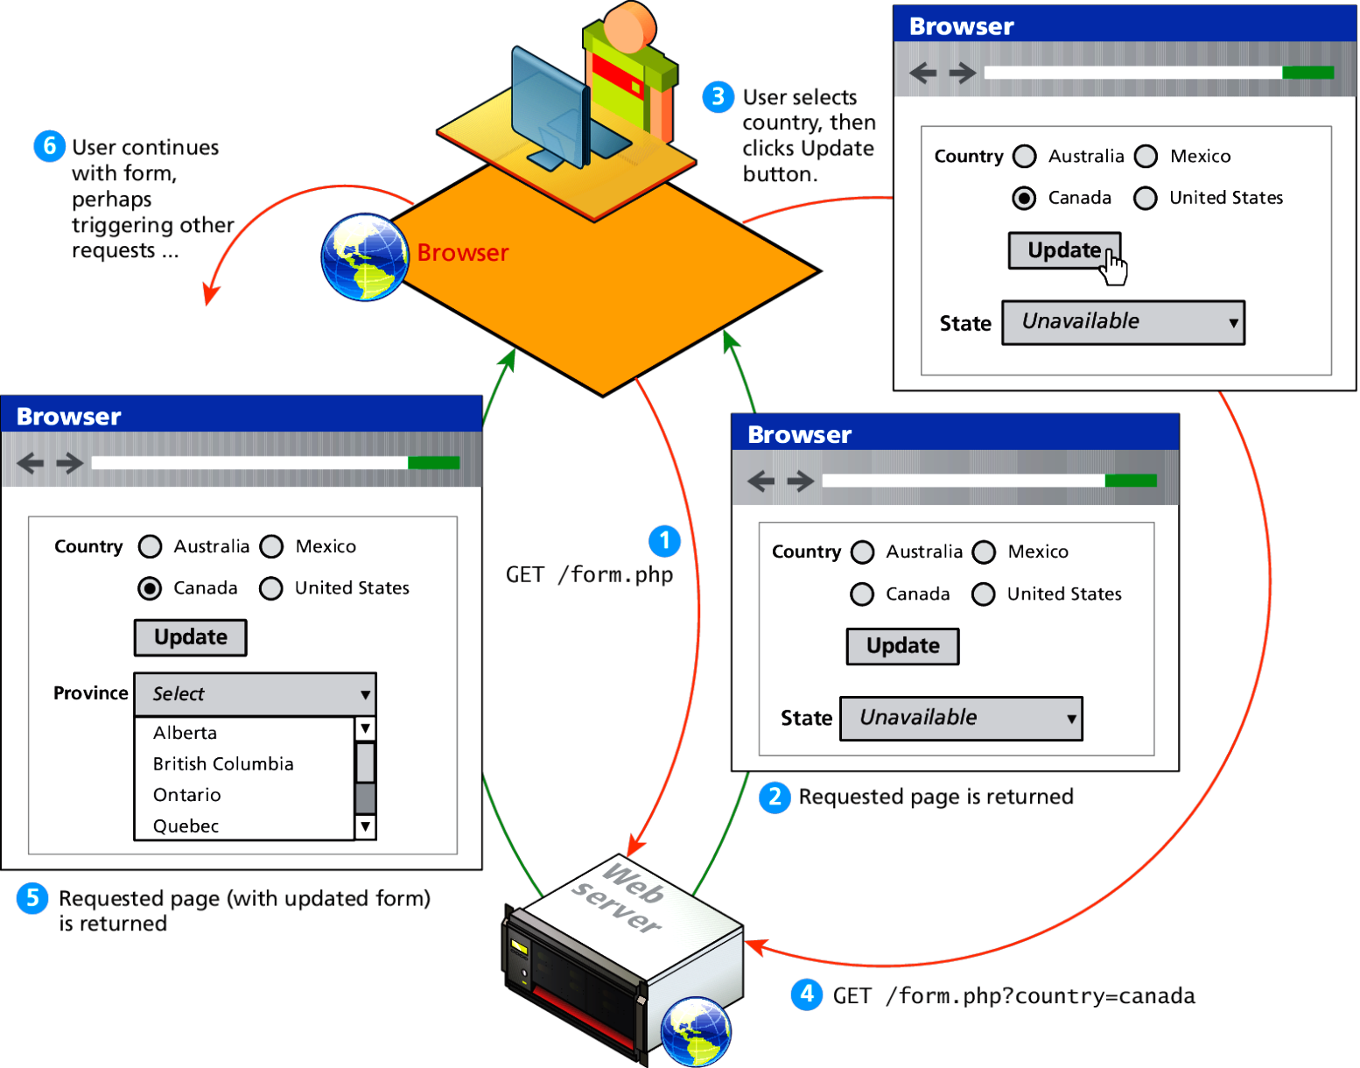
Client-Side Scripting
There are many advantages of client-side scripting:
Processing can be offloaded from the server to the client.
The browser can respond more rapidly to user events than a request to a remote server ever could, which improves the user experience.
There are disadvantages as well:
JavaScript is a little messy and hard to debug.
Unexpected behavior on different browsers.
Without JavaScript

Slide 4
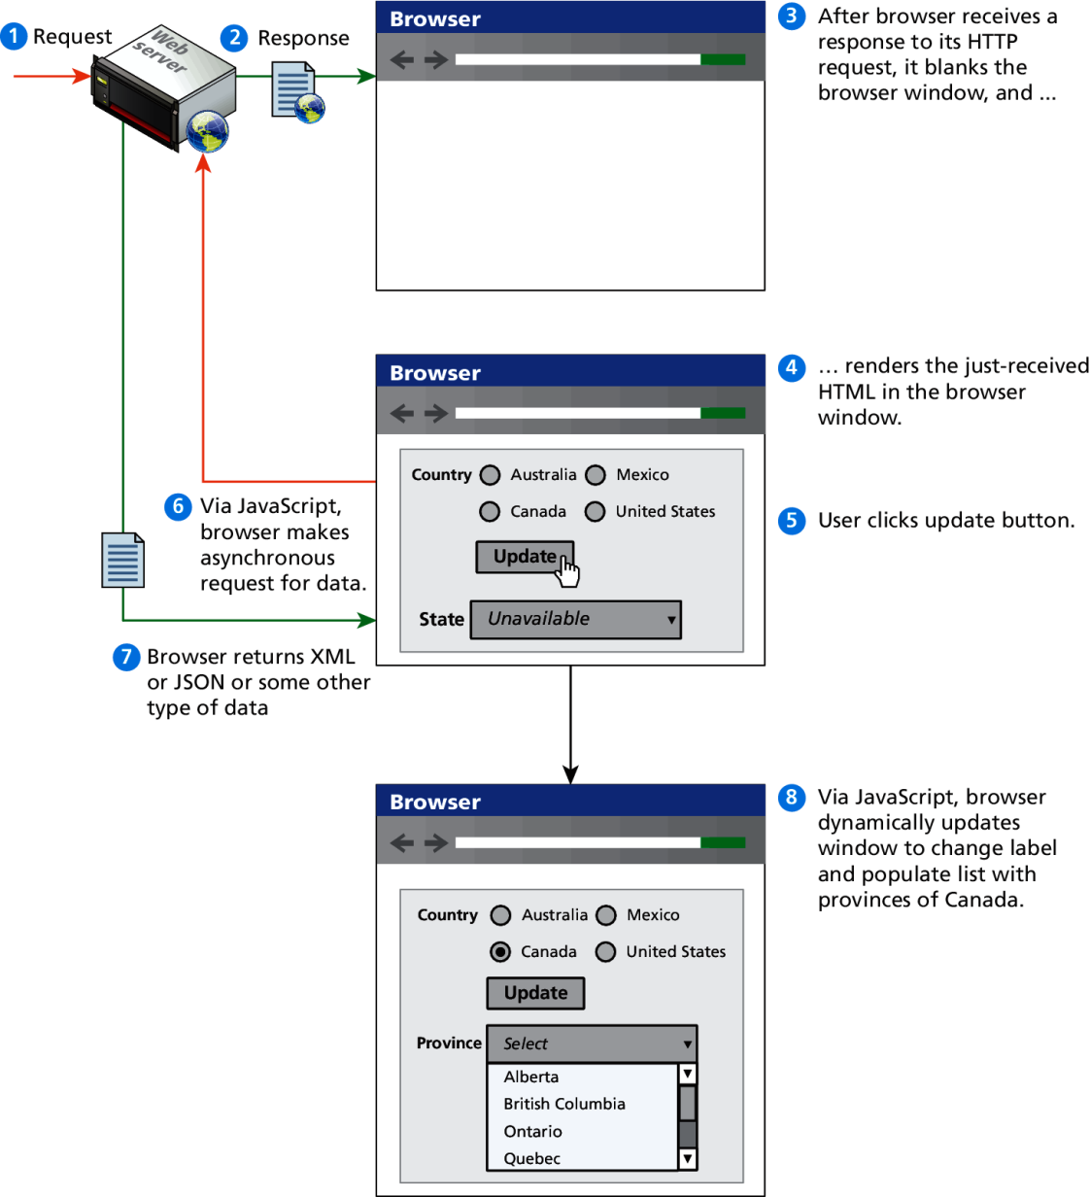
JavaScript / AJAX
JavaScript became a much more important part of web development in the mid 2000s with AJAX.
AJAX is both an acronym as well as a general term.
As an acronym it means Asynchronous JavaScript And XML.
The most important feature of AJAX sites is the asynchronous data requests.

Slide 5
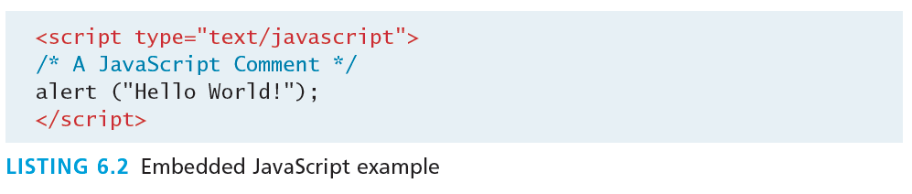
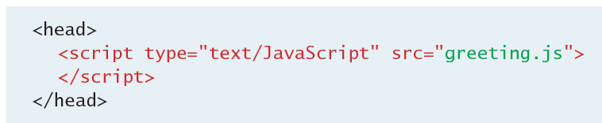
How is JavaScript included?
Embedded JavaScript refers to the practice of placing JavaScript code within a <script> element
In the <head> of a page: scripts are called when an event is triggered
In the <body> of a page: scripts will run as the page loads
External JavaScript refers to allowing links to an external file that contains the JavaScript.
By convention, JavaScript external files have the extension .js.
The same rules apply in regards to how the script is called. If the link is placed in the <head> tag…then its called when an event is triggered. If placed in the <body>, the script is called when the page loads.

Slide 6
What you will need …
Your favorite editor (Sublime, emacs, textedit, etc.)
A web browser, e.g. Chrome, Firefox
Opening a JavaScript interpreter on Chrome
OSX: Command+Option+I
Windows: F12 or Ctrl+Shift+I
Alternatively, you can right click anywhere on any web page and choose “Inspect Element”
To type commands that span multiple lines, use Shift+Enter

Slide 7
JavaScript Syntax
We will briefly cover the fundamental syntax for the most common programming constructs including
variables,
assignment,
conditionals,
loops, and
arrays
before moving on to advanced topics such as events and classes.

Slide 8
JavaScript’s Reputation
JavaScript’s reputation for being quirky not only stems from its strange way of implementing object-oriented principles but also from some odd syntactic gotchas:
The scope of variables in blocks is not supported. This means variables declared inside a loop may be accessible outside of the loop, counter to what one would expect.
There is a === operator, which tests not only for equality but type equivalence.
Null and undefined are two distinctly different states for a variable.
Semicolons are not required, but are permitted (and encouraged).
There is no integer type, only number, which means floating-point rounding errors are prevalent even with values intended to be integers.

Slide 9
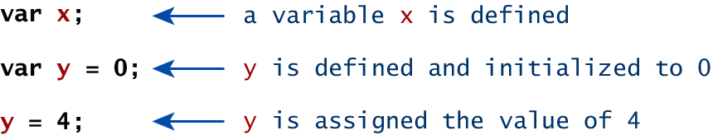
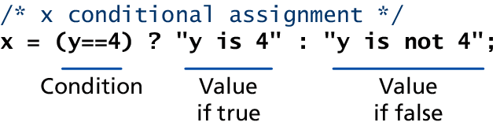
Variables
Variables in JavaScript are dynamically typed, meaning a variable can be an integer, and then later a string, then later an object, if so desired.
This simplifies variable declarations, so that we do not require the familiar type fields like int, char, and String.
Operator | Description | Matches (x=9)
== | Equals | (x==9) is true (x=="9") is true
=== | Exactly equals, including type | (x==="9") is false (x===9) is true
< , > | Less than, Greater Than | (x<5) is false
<= , >= | Less than or equal, greater than or equal | (x<=9) is true
!= | Not equal | (4!=x) is true
!== | Not equal in either value or type | (x!=="9") is true (x!==9) is false

Slide 10
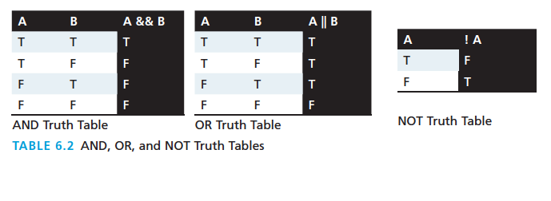
Logical Operators
The Boolean operators and, or, and not and their truth tables are supported.

Slide 11
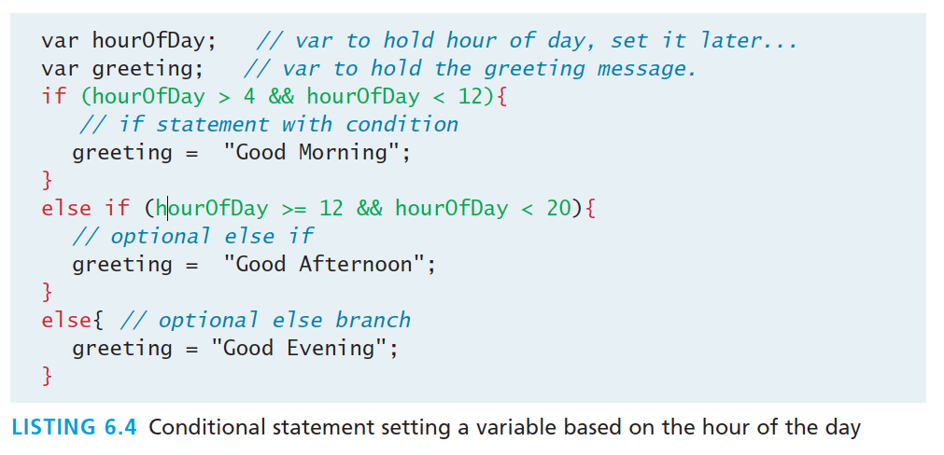
Conditionals
JavaScript’s syntax is almost identical to that of PHP, Java, or C when it comes to conditional structures such as if and if else statements.
In this syntax the condition to test is contained within ( ) brackets with the body contained in { } blocks.

Slide 12
Loops
JavaScript supports for, for/in, while, do/while loops
<!DOCTYPE html>
<html>
<body>
<h1>JavaScript Loops</h1>
<p id="demo"></p>
<script>
var sum = 0;
var text = "Result : ";
for (var i = 0; i < 10; i++) {
sum += i;
}
text += sum;
document.getElementById("demo").innerHTML = text;
</script>
</body>
</html>

Slide 13
Functions
Therefore a function to raise x to the y^{th} power might be defined as:
function power(x,y){
var pow=1;
for (var i=0; i<y; i++) {
pow = pow*x;
}
return pow;
}
And called as power(2,10);
Functions are the building block for modular code in JavaScript.
They are defined by using the reserved word function and then the function name and (optional) parameters.
Since JavaScript is dynamically typed, functions do not require a return type, nor do the parameters require type.

Slide 14
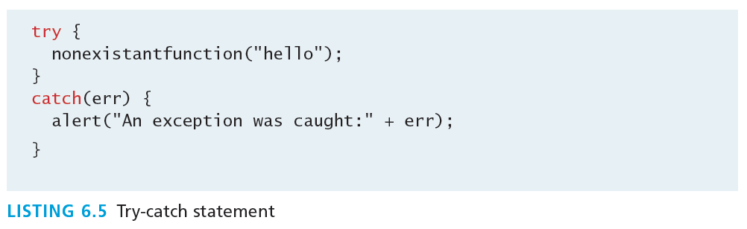
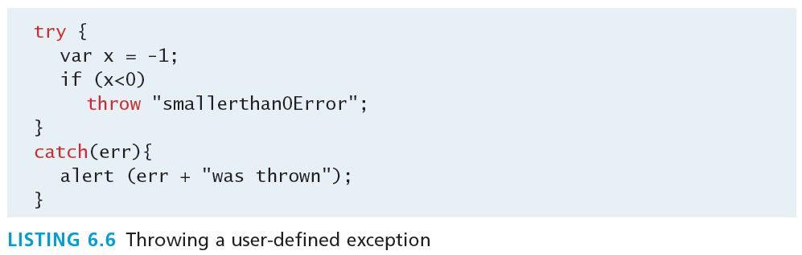
Try/Catch
When the browser’s JavaScript engine encounters an error, it will throw an exception.
These exceptions interrupt the regular, sequential execution of the program and can stop the JavaScript engine altogether.
However, you can optionally catch these errors preventing disruption of the program using the try–catch block

Slide 15
JavaScript Objects (not classes)
JavaScript is not a full-fledged object-oriented programming language.
It does not have classes per se, and it does not support many of the OO like inheritance and polymorphism.
The language does, however, support objects using constructors, properties, and methods.
It also has its own built-in objects:
Array
Boolean
Date
Math
String
Dom objects

Slide 16
Objects (Constructors, Properties, Methods)
Create a constructor and instances based on the constructor
function Person(first, last, age, eyecolor) {
this.firstName = first;
this.lastName = last;
this.age = age;
this.eyeColor = eyecolor;
}
var myFather = new Person("John", "Doe", 50, "blue");
var myMother = new Person("Sally", "Rally", 48, "green");

Slide 17
Arrays
This ‘class’ is defined to behave more like a linked list in that it can be resized dynamically, but the implementation is browser specific, meaning the efficiency of insert and delete operations is unknown.
The following code creates a new, empty array named greetings:
var greetings = new Array();
To initialize the array with values, the variable declaration would look like the following:
var greetings = new Array("Good Morning", "Good Afternoon");
or, using the square bracket notation:
var greetings = ["Good Morning", "Good Afternoon"];

Slide 18
Arrays (Cont.)
To access an element in the array use Java and C-style brackets.
alert ( greetings[0] );
To traverse an array, use the length property:
for (var i = 0; i < greetings.length; i++) { alert(greetings[i]); }
To add an item to an existing array, you can use the push method.
greetings.push("Good Evening");
The pop method can be used to remove an item from the back of an array.
Additional methods: concat(), slice(), join(), reverse(), shift(), and sort()

Slide 19
String
The String object has already been used without us even knowing it.
Constructor usage
var greet = new String("Good"); // long form constructor
var greet = "Good"; // shortcut constructor
String methods
alert (greet.length); // length of a string
var str = greet.concat("Morning"); // Long form concatenation
var str = greet + "Morning"; // + operator concatenation
Many other useful methods exist within the String class, such as
charAt(), indexOf(), split(), search(), and match() methods

Slide 20
Window
The window object in JavaScript corresponds to the browser itself. Through it, you can access the current page’s URL, the browser’s history, and what’s being displayed in the status bar, as well as opening new browser windows.
In fact, the alert() function mentioned earlier is actually a method of the window object.

Slide 21
The DOM
JavaScript is almost always used to interact with the HTML document in which it is contained.
This is accomplished through a programming interface (API) called the Document Object Model.
According to the W3C, the DOM is a:
Platform- and language-neutral interface that will allow programs and scripts to dynamically access and update the content, structure and style of documents.

Slide 22
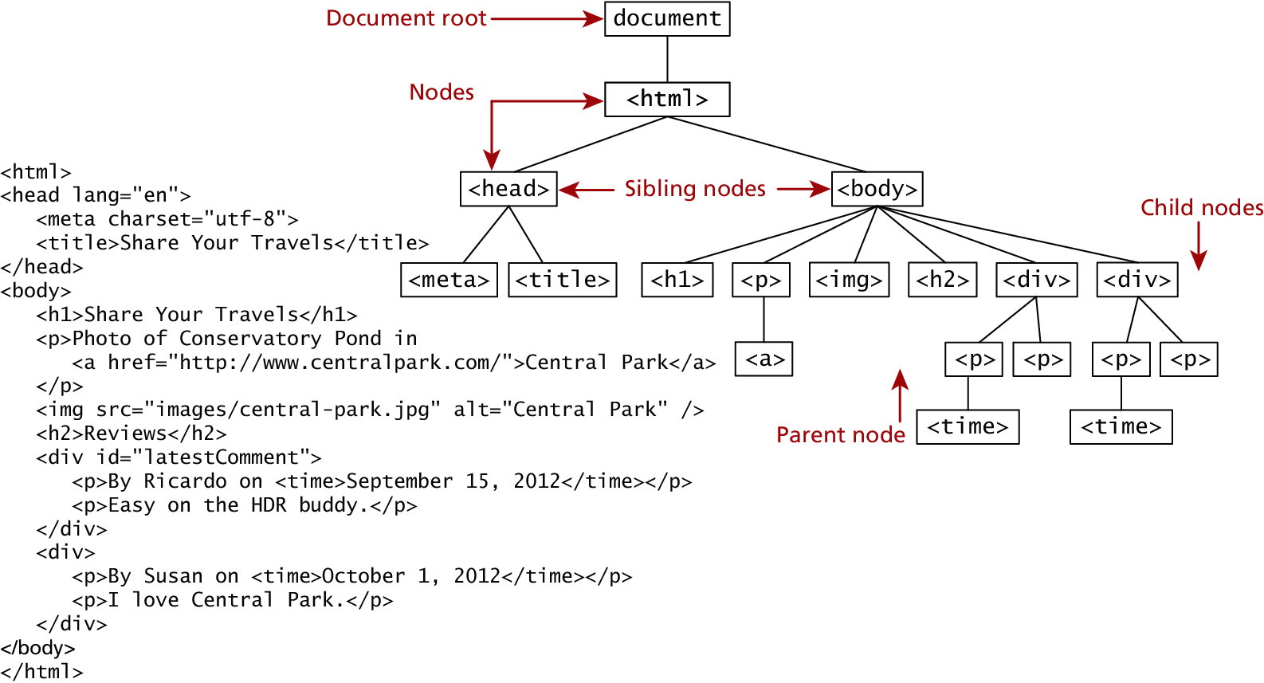
The DOM
We already know all about the DOM, but by another name. The tree structure from HTML is formally called the DOM Tree with the root, or topmost object called the Document Root.

Slide 23
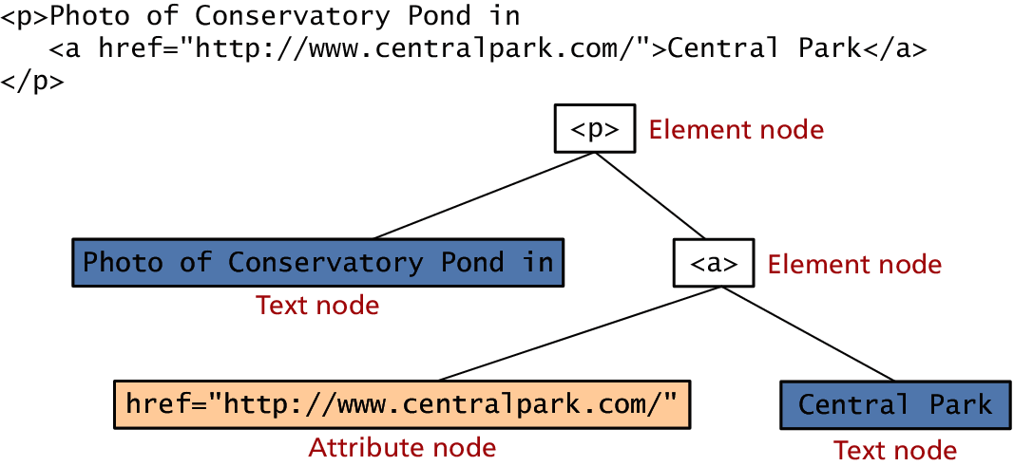
DOM Nodes
In the DOM, each element within the HTML document is called a node. If the DOM is a tree, then each node is an individual branch.
There are:
element nodes,
text nodes, and
attribute nodes
All nodes in the DOM share a common set of properties and methods.

Slide 24
Document Object
The DOM document object is the root JavaScript object representing the entire HTML document.
It contains some properties and methods that we will use extensively in our development and is globally accessible as document.
// specify the doctype, for example html
var a = document.doctype.name;
// specify the page encoding, for example ISO-8859-1
var b = document.inputEncoding;

Slide 25
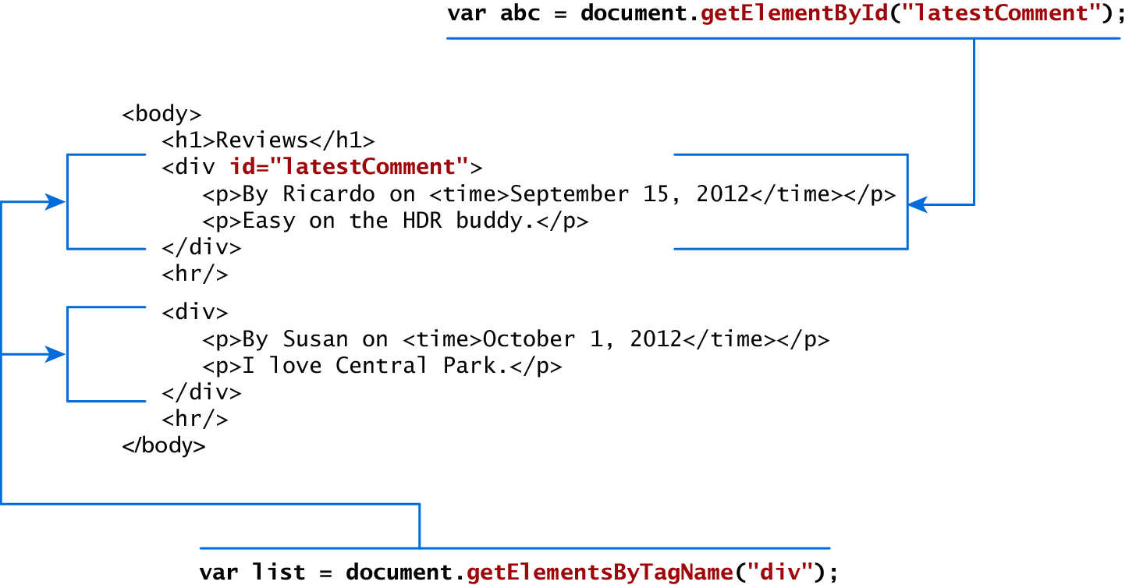
Accessing nodes
Using getElementById(), getElementsByTagName()

Slide 26
Element node Object
Property | Description
className | The current value for the class attribute of this HTML element.
id | The current value for the id of this element.
innerHTML | Represents all the things inside of the tags. This can be read or written to and is the primary way which we update particular div's using JS.
style | The style attribute of an element. We can read and modify this property.
tagName | The tag name for the element.

Slide 27
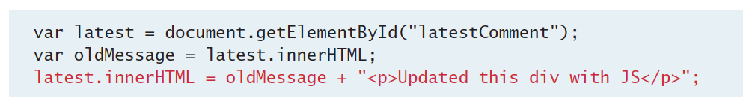
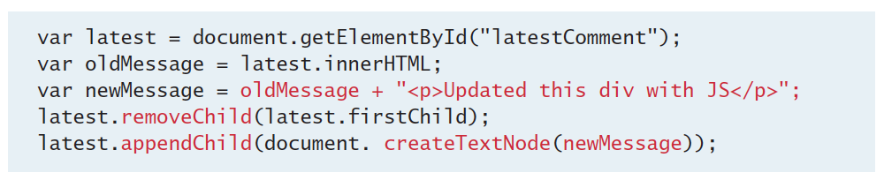
Modifying a DOM element
We can modify the element using the innerHTML property
DOM functions createTextNode(), removeChild(), and appendChild() allow us to modify an element in a more rigorous way

Slide 28
Changing an element’s style
We can add or remove any style using the style or className property of the Element node.
Its usage is shown below to change a node’s background color and add a three-pixel border.
var commentTag = document.getElementById("specificTag");
commentTag.style.backgroundColour = "#FFFF00";
commentTag.style.borderWidth="3px";

Slide 29
JavaScript Events
A JavaScript event is an action that can be detected by JavaScript.
Event types: mouse, keyboard, form, and frame events
We say then that an event is triggered and then it can be caught by JavaScript functions, which then do something in response.
In the original JavaScript world, events could be specified right in the HTML markup with hooks to the JavaScript code (and still can).
As more powerful frameworks were developed, and website design and best practices were refined, this original mechanism was supplanted by the listener approach.

Slide 30
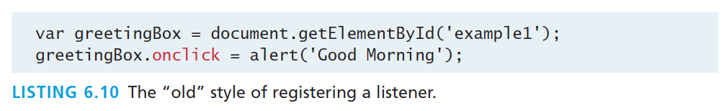
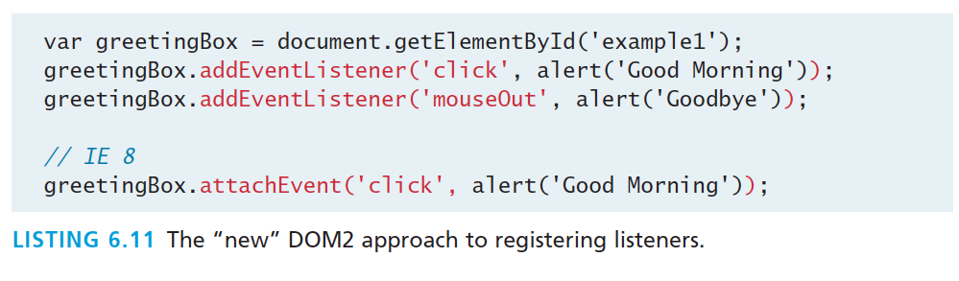
Listener Approach
Two ways to set up listeners

Slide 31
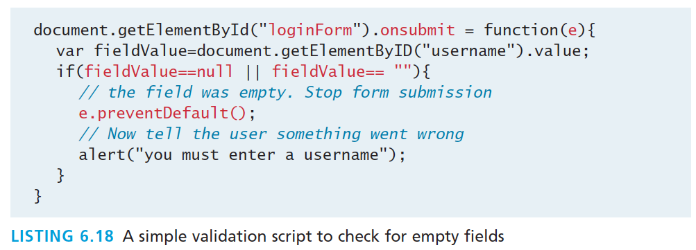
Validating Forms
Writing code to pre-validate forms on the client side will reduce the number of incorrect submissions, thereby reducing server load.
There are a number of common validation activities including email validation, number validation, and data validation.

Slide 32
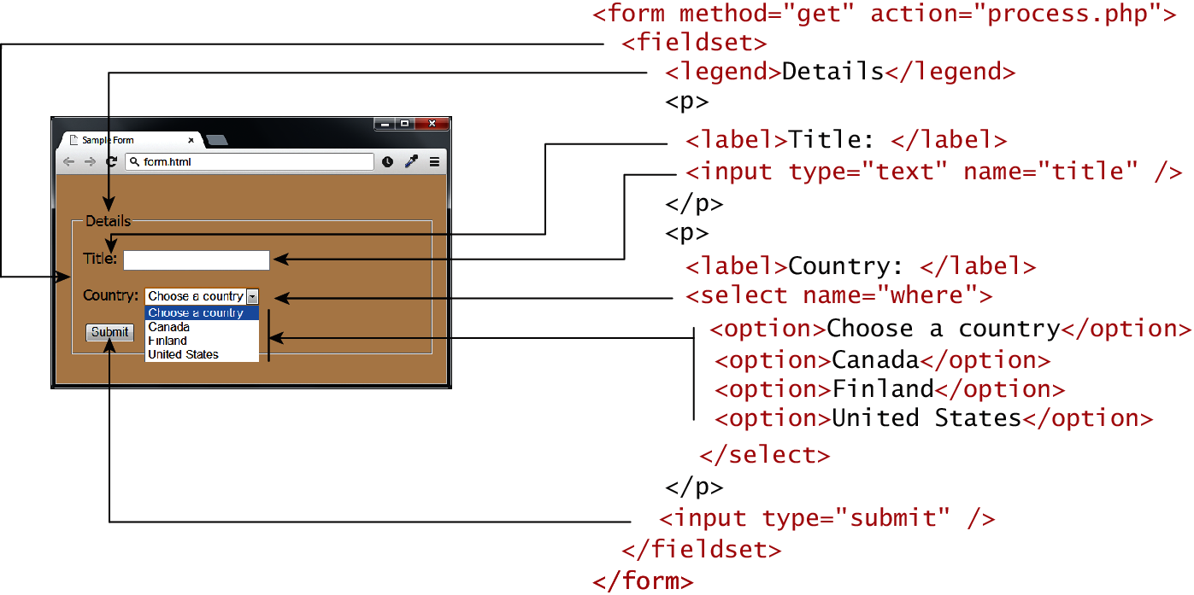
But what is HTML Forms ?
Forms provide the user with an alternative way to interact with a web server.
Forms provide rich mechanisms like:
Text input
Password input
Options Lists
Radio and check boxes

Slide 33
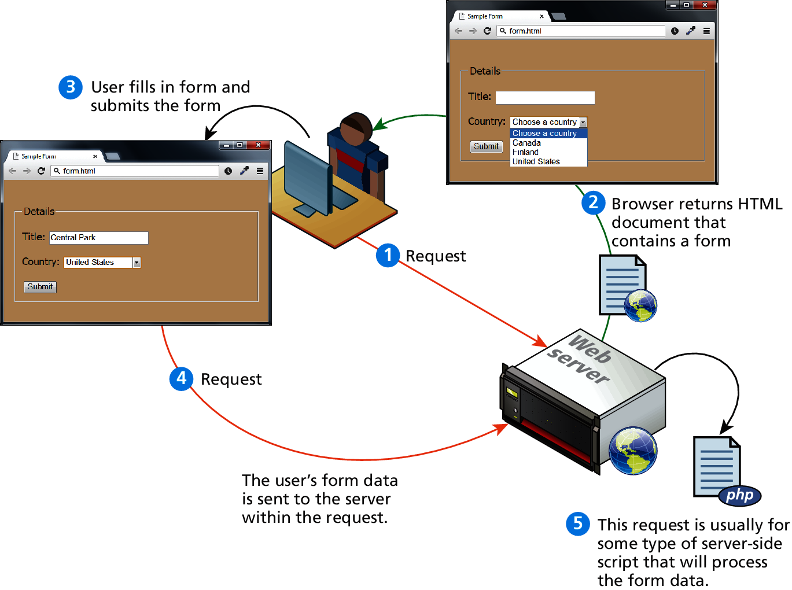
How forms interact with servers

Slide 34
<form> element
Two essential features of any form, namely the action and the method attributes.
The action attribute specifies the URL of the server-side resource that will process the form data
The method attribute specifies how the query string data will be transmitted from the browser to the server.
GET
POST

Slide 35
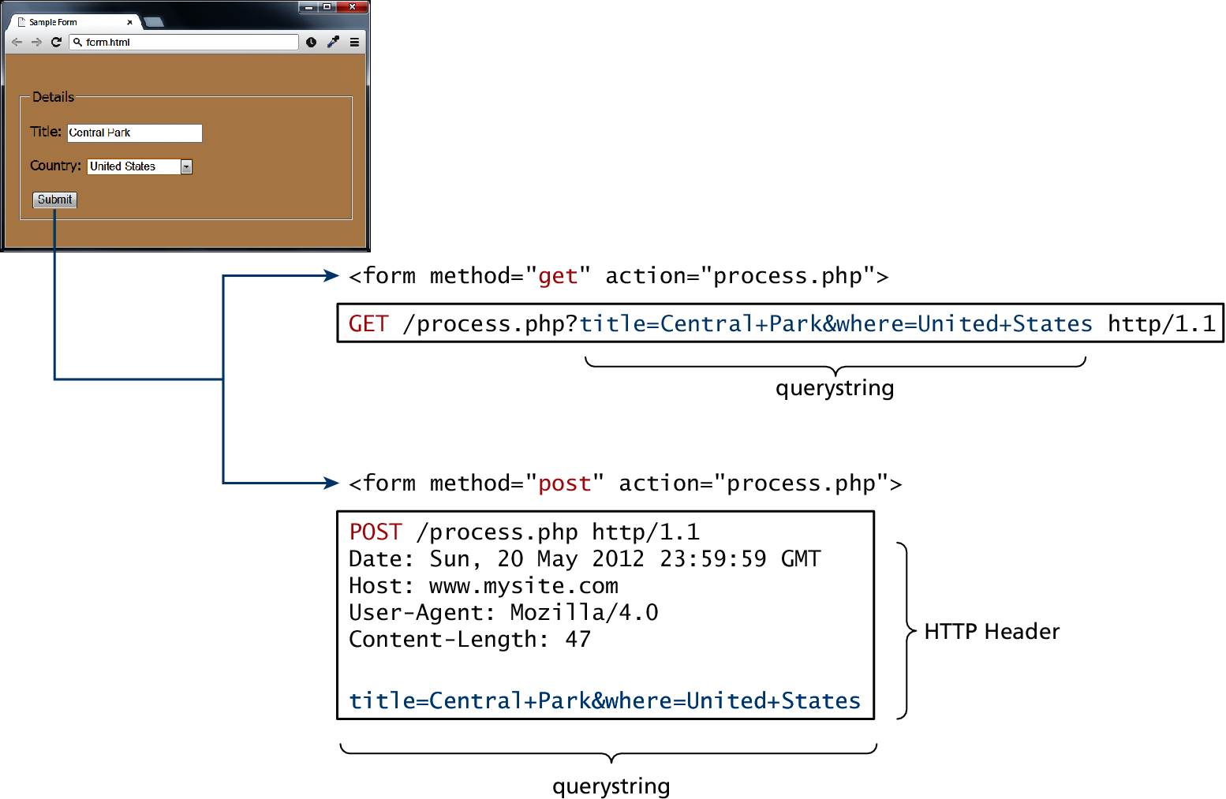
GET vs POST
Advantages and Disadvantages
Data can be clearly seen in the address bar.
Data remains in browser history and cache.
Data can be bookmarked
Limit on the number of characters in the form data returned.
POST
Data can contain binary data.
Data is hidden from user.
Submitted data is not stored in cache, history, or bookmarks.

Slide 36
Next time
Advanced JavaScript
jQuery

